Slide 1
Group 7 Term Project: Housing Database
By Jeremiah Failla, Fola Alonge, and Jaico Nakpil

Slide 2
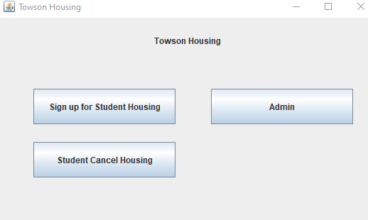
Housing Database Features
Three different Features:
Student Housing Signup
Student Cancel Housing
Admin

Slide 3
Student Housing Signup
Steps to signup for Housing:
Provide the students information
Pick Resident Hall or Apartment
Select the lease length, the building, floor, bed/room, and the meal plan
Select if you want parking and if so enter vehicle make, model, color, and plate number
Confirm the housing lease

Slide 4
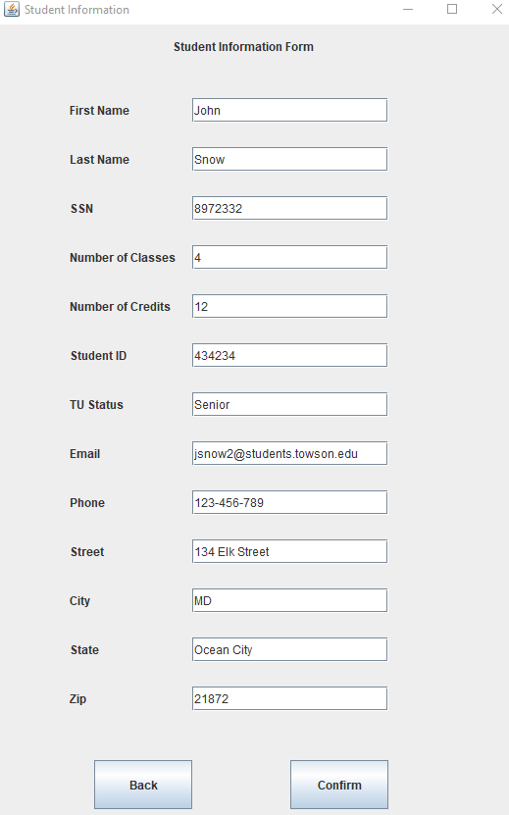
Student Housing Signup
1. Provide the students information

Slide 5
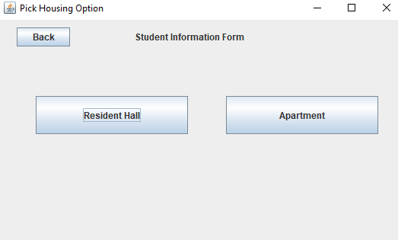
Student Housing Signup
2. Pick Resident Hall or Apartment

Slide 6
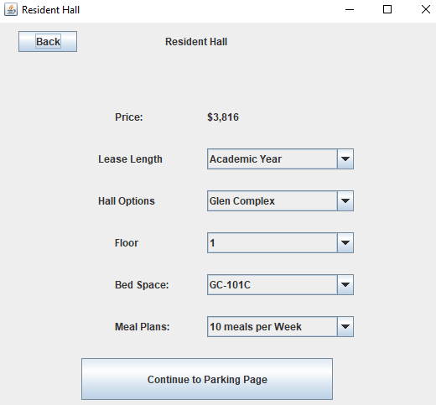
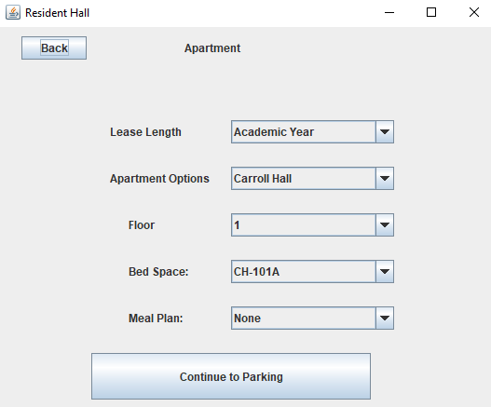
Student Housing Signup
3. Select the lease length, the building, floor, bed/room, and the meal plan

Slide 7
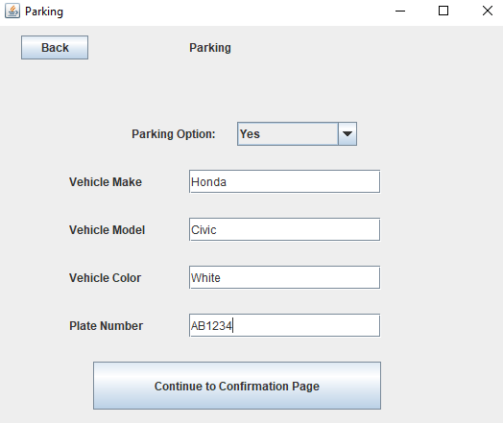
Student Housing Signup
4. Select if you want parking and if so enter vehicle make, model, color, and plate number

Slide 8
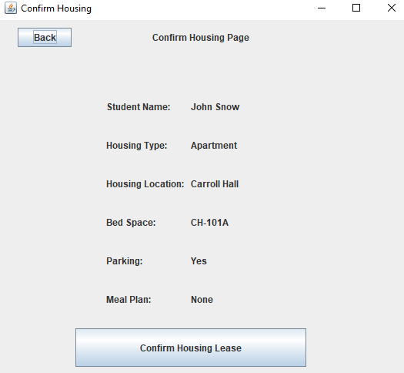
Student Housing Signup
5. Confirm the housing lease

Slide 9
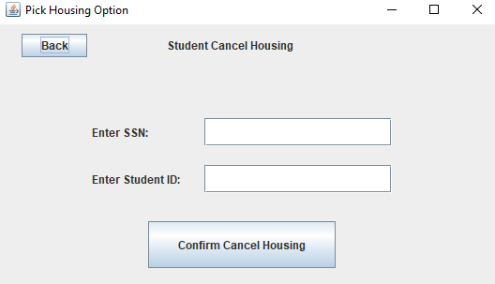
Student Cancel Housing
Cancel Student Housing by entering SSN and Student ID

Slide 10
Admin
Login
View Different Housing Locations
View Different Students in each housing location
Remove a student

Slide 11
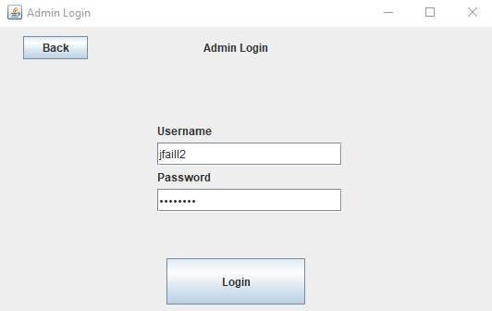
Admin
Login

Slide 12
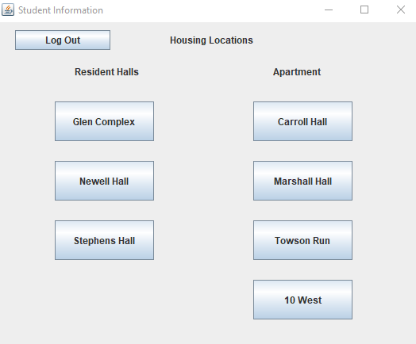
Admin
View Different Housing Locations

Slide 13
Admin
View Different Students in each housing location

Slide 14
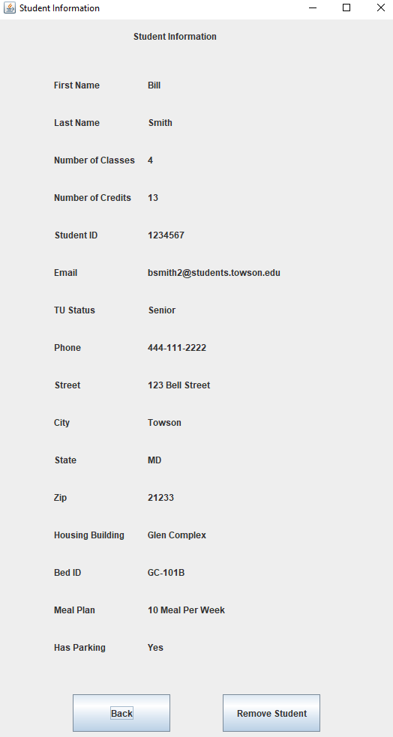
Admin
View Different Students in each housing location

Slide 15
DEMO TIME

